Slide 1
Facilitating Workshops
IIBA February Presentation

Slide 2
Introductions
Timo Loescher
UX Practice Lead
DMI

Slide 3
Agenda
What is a workshop?
Workshop Structure
Workshop Facilitation

Slide 4
What is a workshop?
Notes:
Ask the room –
Who has been in a workshop before?
Who has facilitated one?
Can anyone give me their definition of a workshop?

Slide 5
workshop: noun a meeting at which a group of people engage in intensive discussion and activity on a particular subject or project Merriam-Webster
Notes:
You don’t see the word UX or Design or Strategy or IA or anything like that here, because workshops are focus-agnostic. You can use these techniques to solve pretty much any problem as a team.

Slide 6
workshop: noun any 2(ish)+ hour meeting with a team where the focus is to DO something in particular Timo Loescher
Notes:
MY definition is slightly more broad and open, and basically argues that any goal-driven meeting can be structured and conducted like a workshop if you can dedicate the time and resources to it, the goal is to DO some series of activities to produce some outcome.

Slide 7
breeds of Workshop
Discovery
Empathy
Design
Prioritize
Critique
Notes:
Many breeds – I don’t think this list covers them all – those of you who have been in or conducted a workshop, what “breed” was it? What was the goal?
Discovery: Elict and understand processes, journeys, requirements, etc
Empathy: Better understand users based on previously conducted research, empathy activities, or by involving users in the workshop
Design: Try to take pain points and understanding to drive toward a future state conceptual design
Prioritize: Understand and evaluate various aspects of things to get a sense of priority and align on roadmap and direction
Critique: Discuss events or deliverables of some kind and explore how to better accomplish those ideas and artifacts moving forward.

Slide 8
Workshop Structure

Slide 9
General Structure
Grounding
Diverging
Emerging
Converging
Target

Slide 10
General Structure
Grounding
Diverging
Emerging
Converging
Target
Notes:
Grounding
Try to help everyone understand why they are here, what we know about the problem, share their understanding of the problem, come to a general consensus about the problem at hand
Business Goals and Purpose
Expectations
Ground Rules and Working Agreement
Establish Parking Lot
Scope

Slide 11
General Structure
Grounding
Diverging
Emerging
Converging
Target
Notes:
Diverging
Inspire unique, creative ideas at an individual or small teams level to force people to use unique perspectives to address parts of the greater problem
Discuss activities in more detail next week:
Come up with various ideas, typically more wild or specifically targeting a particular idea to ensure ideas are varied and different

Slide 12
General Structure
Grounding
Diverging
Emerging
Converging
Target
Notes:
Emerging
Explore rough ideas in different ways to poke holes and uncover new viewpoints
Discuss activities in more detail next week:
Goal is to take ideas and iterate, explore, enhance, discuss, and look at from different angles

Slide 13
General Structure
Grounding
Diverging
Emerging
Converging
Target
Notes:
Converging
Bring disparate, opened, creatively-ideated thoughts together to approach an innovative multi-faceted solution
Discuss activities in more detail next week:
Goal is to take different ideas and combine or reduce into a single aligned upon direction and understanding

Slide 14
General Structure
Notes:
Simple standard workshop
Some quick examples
Design – maybe what people typically think/expect, especially when the DMI UX practice lead is the one presenting…
Grounding: establish goals and constraints
Diverging: Brainstorm on various ideas based on different pain points
Emerging: Look at those ideas from different view points (business objectives, tech feasibility, user satisfaction, etc.)
Converging: Combine best features from different ideas into a single design direction
Backlog grooming/refinement
Grounding: establish point basis, then over the course of the grooming session, you repeat the following
Diverging: individuals determine point values individually (planning poker)
Emerging: Discuss why point values may be separate (looking at things from different viewpoints, discussing)
Converging: Agree upon a point value

Slide 15
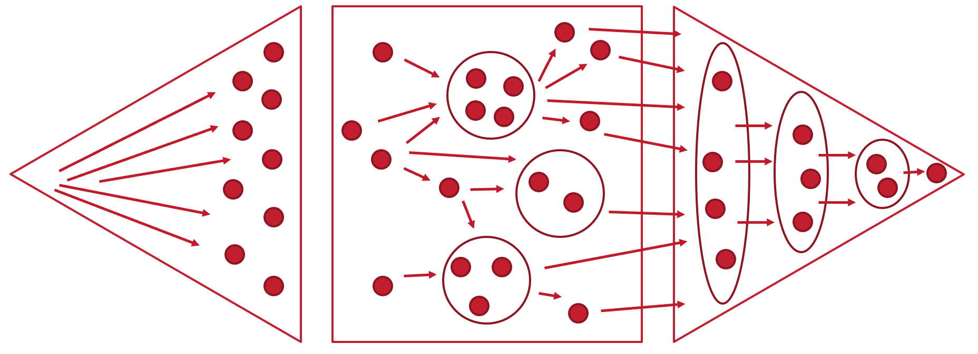
VARIATIONS
Notes:
Chain multiple workshop activities back to back over multiple days

Slide 16
VARIATIONS
Notes:
Maybe meta workshop where you break into teams and iterate separately before coming back together at the end. I have seen corporate strategy teams operate something like this, where a large set of ideas of initiatives are generated explored, categorized, and discussed. Then each of the highest priority ideas gets a steering committee that dives in and ideates around their topic set. Months later, they converge and reprioritize based on outcomes.

Slide 17
CONSTRAINTS ARE GOOD
Notes:
Sometimes we want people to explore wild ideas, but even then, adding constraints helps them focus thoughts.
We have an activity that encourages divergence by using constraints (counterintuitive, I know). Imagine you had to solve this pain point for an astronaut and you had to use a mobile phone to do so – get people to think far out but in constrained way.
Similarly, once you start to focus in, technical, regulatory, and process constraints allow you to ensure the converged ideas are actually feasible.

Slide 18
Types of Constraints
Rules for interactions
Boundaries in time and space
Artifacts that hold information about the activity
Goals or an end-state that everyone is working toward
Notes:
Boundaries – must use sticky notes, only get 5 minutes, etc

Slide 19
Workshop Facilitation

Slide 20
Role of facilitator
Notes:
Lets say you are then organizing a workshop to get a problem solved.
What is your responsibility as the facilitator?

Slide 21
Role of facilitator
To make easy
Notes:
To make easy is literally the definition of facilitate
So how can you “make easy?”

Slide 22
Four Main Goals of a Facilitator
Encourage full participation
Promote mutual understanding
Foster inclusive decisions
Cultivate shared responsibility
Notes:
So how can you “make easy?”

Slide 23
Role of facilitator
F feedback solicitation
A active listening
C create space
I improvise
L lean into the group purpose
I if you don’t know, say so
T take everything as relevant
A avoid advice
T to thine own self be true
E embrace conflict
Notes:
In a more practical sense, you can rely on this acronym to “make easy” – or you can look at it and just notice how it kind of makes an acronym that you will never likely remember, but reference it while you facilitate.

Slide 24
feedback Solicitation
F
Notes:
Listen for feedback throughout, and make sure to get feedback afterwards to get better over time
Anthem: emergence activities felt like they were spinning and wanted to take all the ideas forward, people starting to disengage, so we adapted and moved into a mini-grounding activity to set technical constraints and expectations for convergence and moved on to convergence rather than continuing to emerge for another hour as planned

Slide 25
active listening
A
Notes:
Listen to what is said, process it, and repeat it back out in your own words to ensure you and others in the room clearly heard and understood

Slide 26
create space
C
Notes:
Create space: Ask them to reflect on someone else’s comments – give time for people to think. Try to encourage people to think of alternative viewpoints, ideas, and options.

Slide 27
improvise
I
Notes:
Plan the workshop, and put a lot of thought into the various activities. However, your focus in planning is to have meaning in why you chose those activities. If the why changes (and it almost always does), be flexible and change your plan.
Anecdote: Card sorting workshop at Hil-Rom (I think?). Caleb had planned a card sworting workshop, they felt that they had already done finished their IA so we pivoted and “validated” the IA with a different activity ;)

Slide 28
lean into the group purpose
L
Notes:
Don’t be afraid to remind the group of the ultimate objective, and to help them understand how each activity helps them get to that end goal. Keep people on task and focused. Sometimes that means cutting someone off – think about the fact that you are protecting the time and efficiency of everyone else in the room.

Slide 29
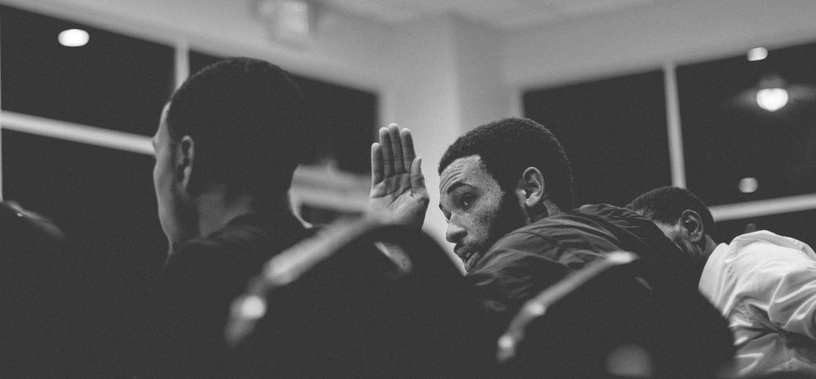
if you don’t know, say so
I
Notes:
Don’t be afraid to ask questions. If you aren’t sure of something (assuming you’ve been paying attention), there is a decent chance someone else doesn’t know. Take the fall for the group and ask the “dumb” questions to help everyone feel equally involved.

Slide 30
take everything as relevant
T
Notes:
Know that you will find very important things that aren’t super relevant to this workstream, but it is relevant to someone and likely to the organization. Parking lot it, come back to it in the follow up. Listen to the people that represent the minority – just because they may be drowned out doesn’t mean their point isn’t valid.

Slide 31
avoid advice
A
Notes:
When you are a facilitator, you are not a participant. Ultimately, you job is to make the workshop go smoothly. If they ask you a question about your previous experiences, feel free to give them that info, but don’t jump into discussions or ideation directly if you can help it. As a facilitator, you SHOULD NOT PARTICIPATE in activities – you have power in the activities and you will sway opinions if you participate. Take off the hat if you need to be in the activities.
“That’s one way to do it”

Slide 32
to thine own self be true
T
Notes:
Bring your own personality, style, and flavor. There is not “right” way to facilitate.

Slide 33
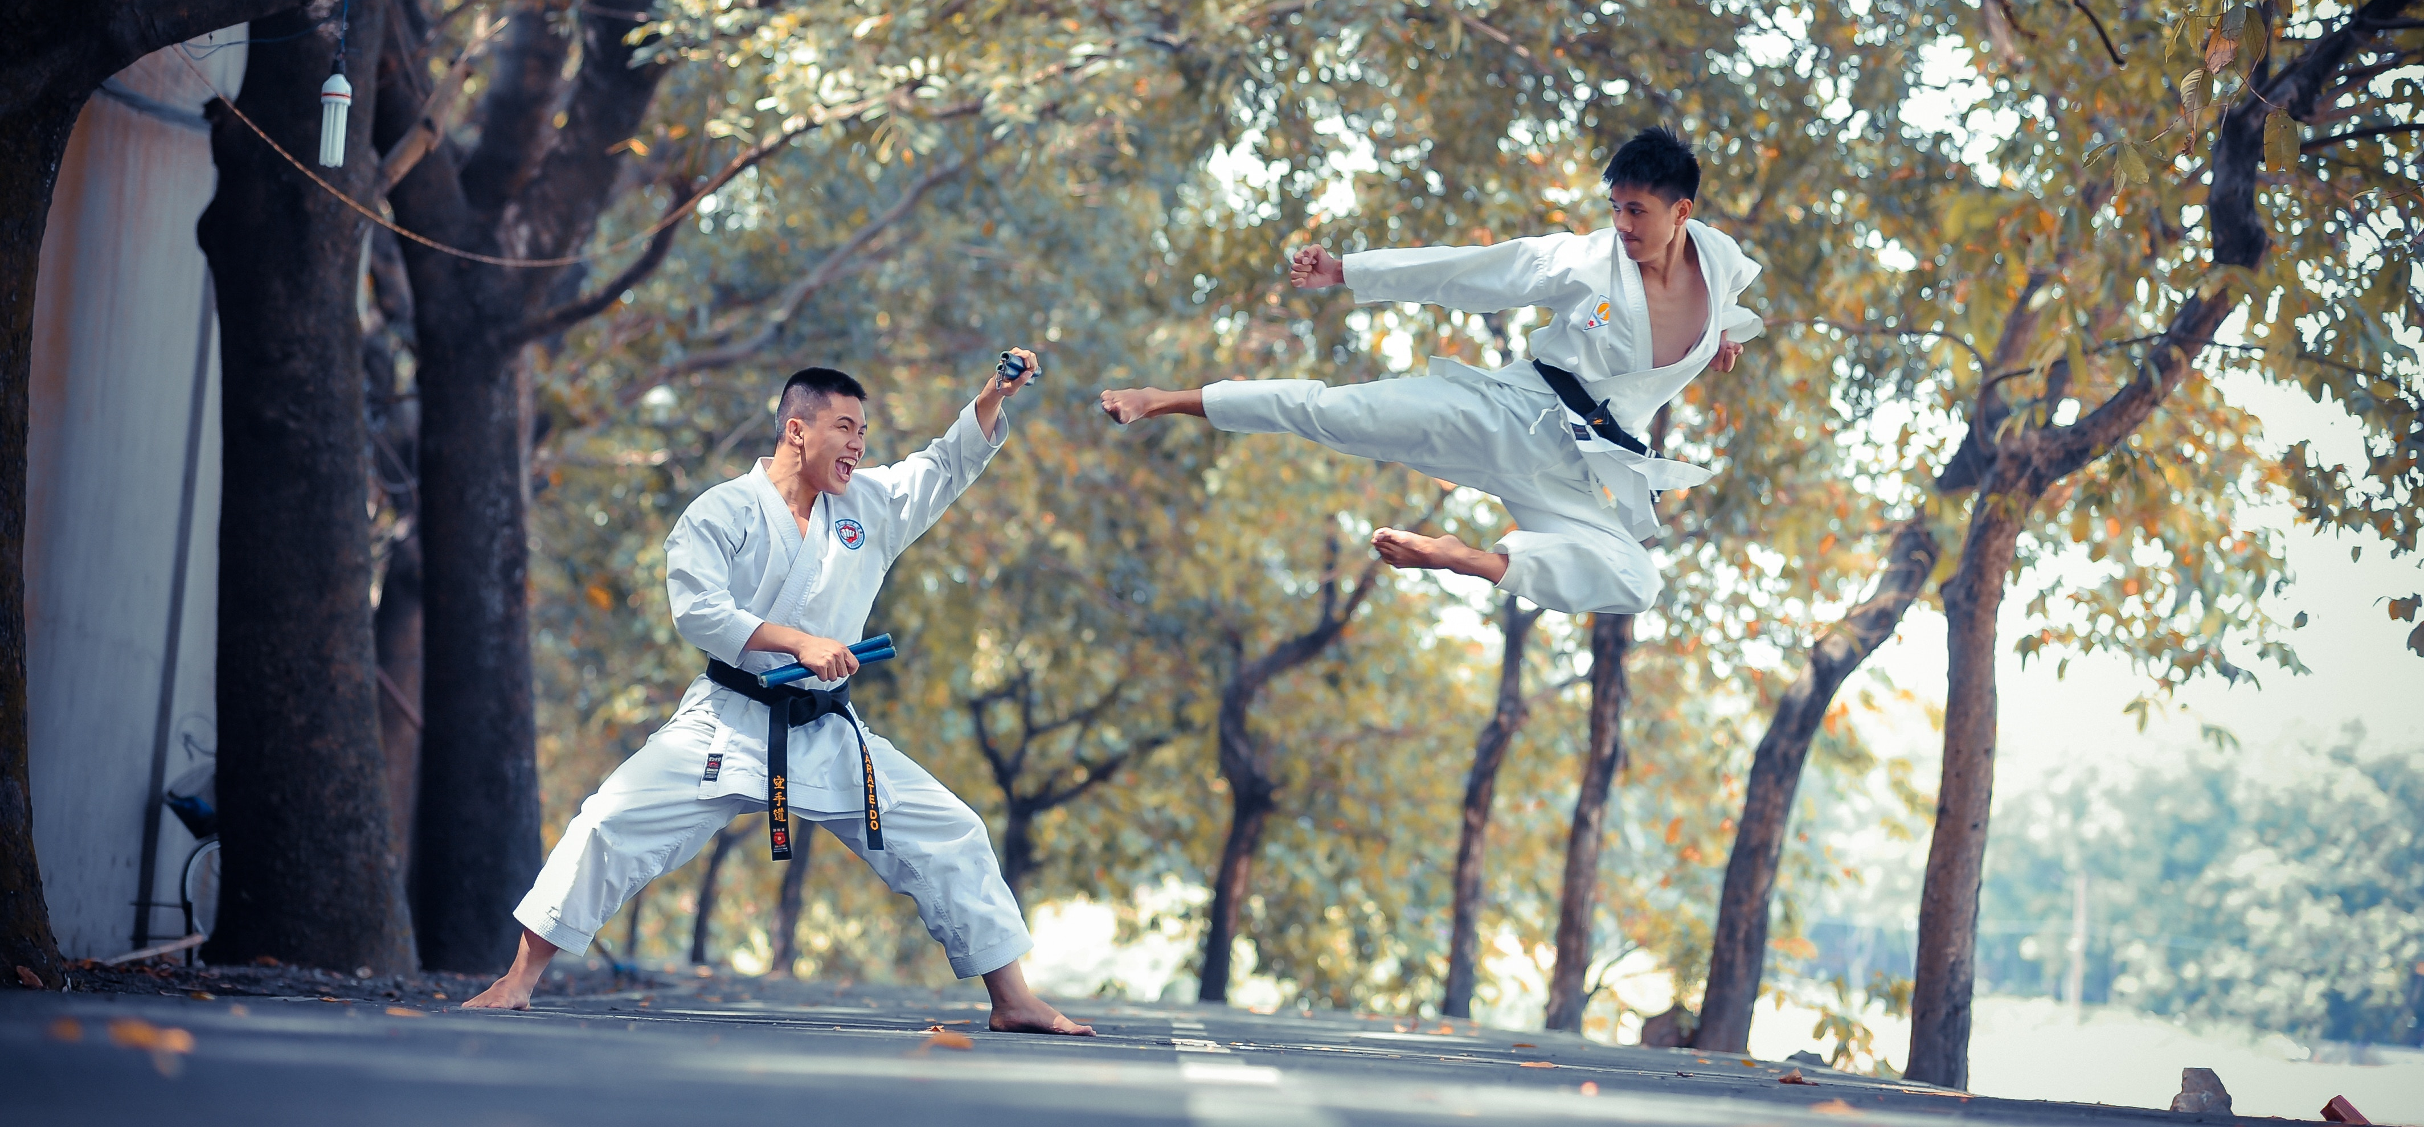
embrace conflict
E
Notes:
If people have dissenting opinions on a topic, you don’t need them to pull on boxing gloves, but have them explain their points of view one at a time and see what others think. If everyone agreed 100% of the time, you likely wouldn’t have needed the workshop and the issue could have been solved in an email.

Slide 34
Facilitation Techniques
Paraphrase
Create Expansion
Use Intentional Silence
Link
Encourage
Create Space
Notes:
Paraphrase: "Let me see if I understand...“ "I think what you're saying is...“
Create Expansion: “Can you give me an example?” “Can you tell me more about that?”
Use Silence: Even if you feel awkward, the silence is MORE awkward for them. In an interview, try to make it to 7 secs
Link: “Can you tell me how that relates to…”
Encourage: Use an individual's role or area of expertise as an excuse to call on someone. "Everyone in this room is here because of their expertise and the value they bring.“ "Is this raising questions for anyone?“ "Does anyone want to add anything? It feels like something is missing.“
Create space: Ask them to reflect on someone else’s comments – give time for people to think

Slide 35
Facilitation Techniques
Paraphrase
Create Expansion
Use Intentional Silence
Link
Encourage
Create Space
Find Common Ground
Summarize
Balance
Use a Parking Lot
Create Artifacts
Sketch
Notes:
Find Common Ground: “It sounds like we are not in agreement in these areas…” “It sounds like the common ground might be….” “Let’s keep moving forward”
Summarize: “We just covered these things, next we’ll be moving to this…”
Balance: Balance content being created in addition to personalities in the room. “It sounds like we’re coming up with great ideas, now let’s play devil’s advocate…” “As a [designer] how might you look at this?”
Use a Parking Lot: “This merits a bigger discussion.” “We’re too in the weeds; let’s table this for now.” You can assign action items from the Parking Lot
Create Artifacts: can create artifacts prior to switching to a new activity “Is everyone in agreement? Put your initials on this if you’re onboard.” Artifacts can summarize the entire workshop (e.g. slide deck of photos, video / time lapse, etc.)
Sketch: Sketching takes disparate ideas in peoples heads and gets them into a shared reality. It is easier to react to something that is written or drawn out and adjust to come to greement. Use Sticky notes, flip charts, whiteboards etc. to draw simple diagrams and outline ideas with bullet lists

Slide 36
Building Empathy with Resistors

Slide 37
How to Group People
Amplify differences in perspectives, backgrounds, personalities
Requires understanding
Stakeholder Matrix for invitee planning
Notes:
Understanding the stakeholders at play is key
Try to diversify (if possible) on:
Cultural Differences
Organizational/role differences
Goal differences
Background differences
Right vs left brained folks
User-centric vs business-centric vs IT-centric folks
Try to group (if possible) on:
Personality bearing similarities (group load dominating people together and quiet reserved people together to avoid steamrolling)
Org hierarchy similarities (group people at similar organizational hierarchy to avoid power dynamics)
Helpful to create, in advance, a matrix with these traits and identify possible group makeups
May want to consider switching groups between activities if dynamics aren’t working as expected. Its useful to have this at you disposal to aid in those changes

Slide 38
How to Deal with Problem Children
Dominating
Quiet
Dominators
Notes:
Dominating and Quiet – Instead of asking open questions (“What do you guys think of X?”) try directing questions (“What do you think of X, Mary?”). Also you can limit the impact by grouping up into side discussions, or force each person to give their thoughts by having them write down ideas then go around and have each person read their ideas before discussing.

Slide 39
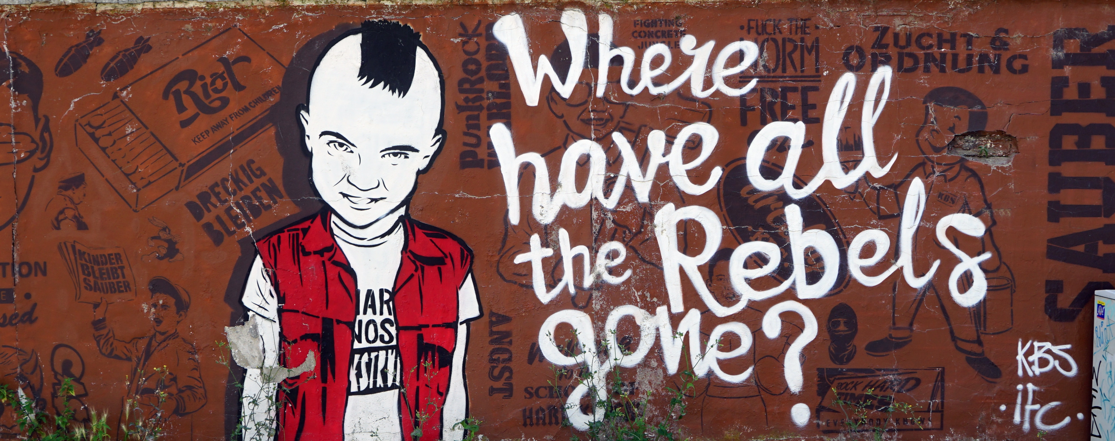
How to Deal with Problem Children
Dissenting
Dissenters
Notes:
Dissenting – Acknowledge concerns, and see if anyone else shares them. If they do, recognize them and show how the activities planned will address those concerns and how they aim to bring them to the end goal. Dissension typically comes from either a competing personal agenda or from a misunderstanding of the activities’ purposes. Remind of blue sky purposes and reframe discussions if fixating on some things.

Slide 40
How to Deal with Problem Children
Sidebars
Notes:
Sidebarring – Lean on the parking lot – “do you guys have something to add to this?” If not, “should we add to the parking lot?” Football flags. If someone is the problem, make them the star (have them write ideas on the whiteboard for example).

Slide 41
How to Deal with Problem Children
Disengaged
Disengaged
Notes:
Disengaged – Proctor (can work for Sidebars as well). Stand over, next to, or behind someone playing on their phone; and engage them directly See if you can tailor the activities such that they are more directly applicable to their goals. Provide regular “tech breaks” and really encourage people to check on their emails “so they don’t get disrupted during the next hour.” Have a 1:1 and see if they need to be included. People shouldn’t be in the room if they cant be engaged while they are there

Slide 42
Thanks!
Notes:
Plug ux as being able to help with people workshops if needed

Slide 43
Ground Rules (starter List to consider)
Parking Lot/scope protection
Safe Space – embrace conflict professionally
Be comfortable challenging ideas
“Tech Breaks”
How we will deal with sidebars
Football flags example
Agreement on time management/timeboxing
Notes:
Note: I like to open these up to the team. Show some initial rules and have a discussion with the group so they feel like they own their rules.

