Slide 1
International Institute of Business Analysis

Slide 2
Tonight’s Experience
Set Context – Core Agile Principles
Agile Frameworks
Debunk Agile Myths
Lean Coffee/QA Conversation

Slide 3
Agile Mindset
An agile mindset is the set of attitudes supporting an agile working environment. These include respect, collaboration, improvement and learning cycles, pride in ownership, focus on delivering value, and the ability to adapt to change

Slide 4
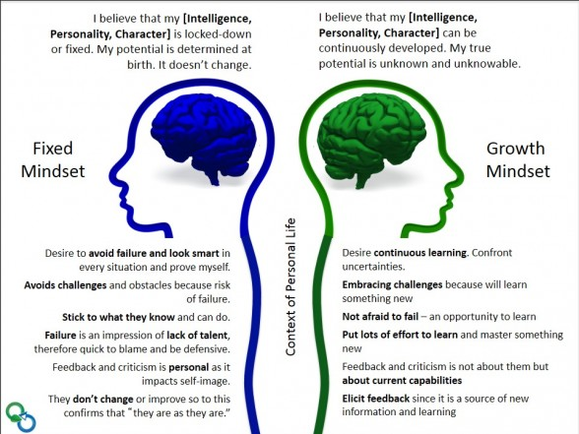
Agile Mindset

Slide 5
Agile Frameworks
Agile Scrum Methodology.
Lean Software Development.
Kanban.
Extreme Programming (XP)
Crystal.
Dynamic Systems Development Method (DSDM)
Feature Driven Development (FDD)

Slide 6
Agile Frameworks
XP is based on communication, simplicity, feedback, courage, and respect (pair programing, peer reviews, swarming)
Scrum framework is based on the Empirical Process. This principle emphasizes the core philosophy of Scrum based on the three main ideas of transparency, inspection, and adaptation
Lean – Based on Lean Manufacturing – The Lean Approach begins with a detailed understanding of what value the customer assigns to product and services – The Value Stream, Flow, Pull, Elimination of Waste

Slide 7
Agile Adoption Pattern – Shu Ha Ri
Shu – In this beginning stage the student follows the teachings of one master precisely. He concentrates on how to do the task, without worrying too much about the underlying theory. If there are multiple variations on how to do the task, he concentrates on just the one way his master teaches him.
Ha – At this point the student begins to branch out. With the basic practices working he now starts to learn the underlying principles and theory behind the technique. He also starts learning from other masters and integrates that learning into his practice.
Ri – Now the student isn’t learning from other people, but from his own practice. He creates his own approaches and adapts what he’s learned to his own particular circumstances.

Slide 8
Roles and Titles
A "job role" is a description of what a person does. A "job title" is a convenient name for a role. ... But a job role is the application of talents and abilities specific to a situation. A person holding a job title can have different roles in different situations.

Slide 9
What’ Missing
Management – Resource Managers
Strategic – Product Managers/Business Relationship Managers
Agile Project Managers – Release Train Engineers
Most conversations FOCUS on the TEAM…
BUT…. OTHER
WORK still EXIST before it gets to the TEAM and while the team is building the product.

Slide 10
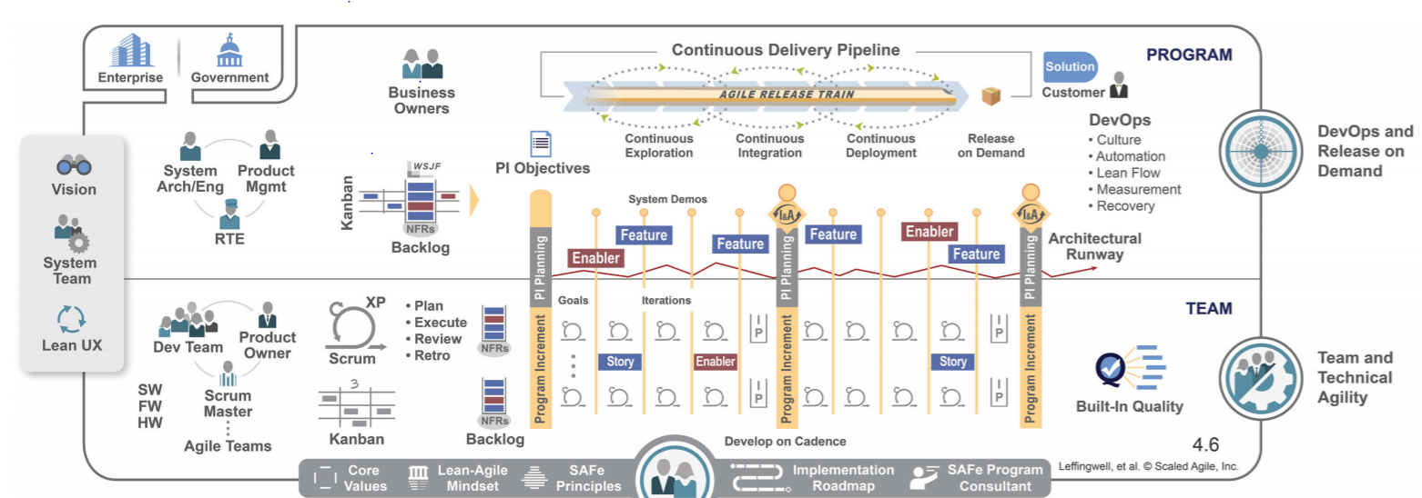
Agile Reality

Slide 11
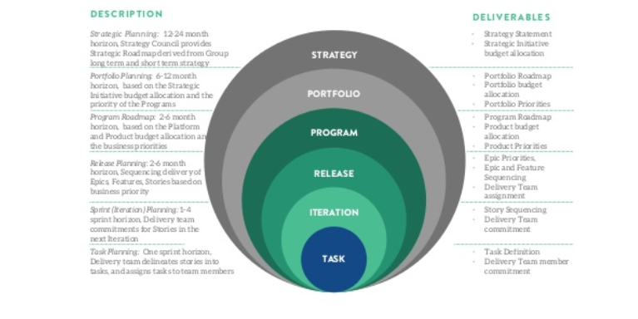
Agile Reality

Slide 12
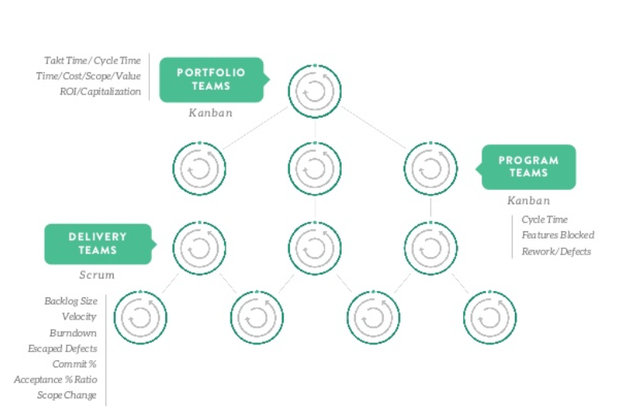
Agile Reality

Slide 13
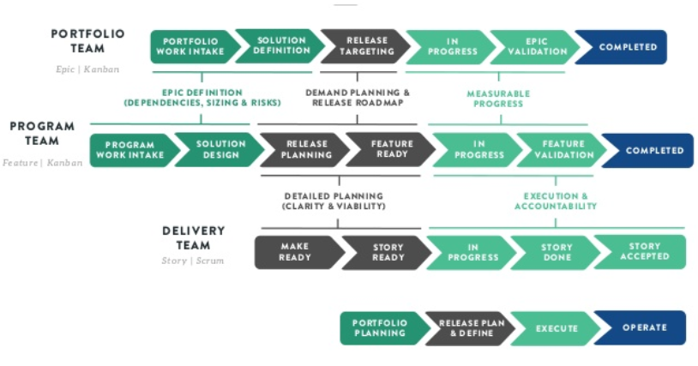
Agile Reality

Slide 14
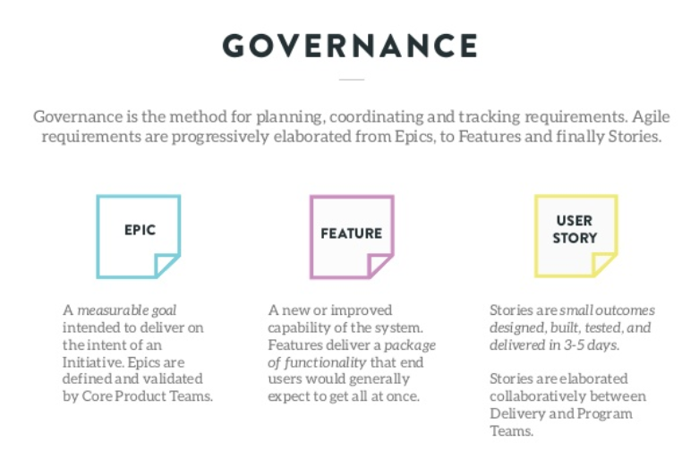
Agile Reality

Slide 15
Agile Reality

Slide 16
Agile Reality

Slide 17
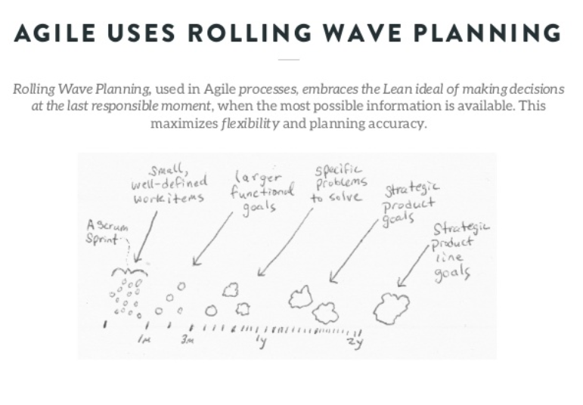
Agile Reality

Slide 18
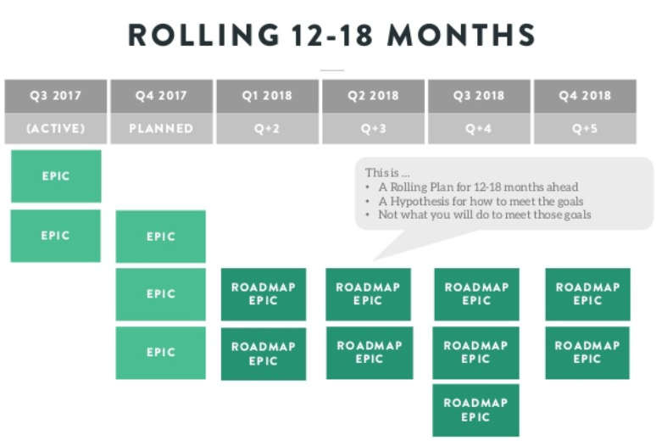
Agile Reality

Slide 19
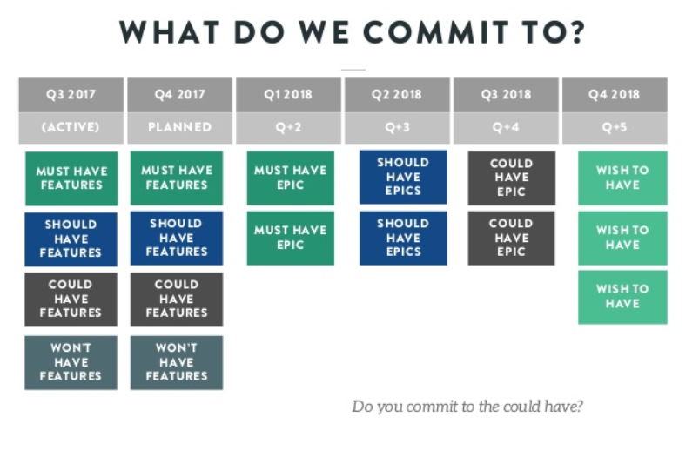
Agile Reality

Slide 20
Strategic - Portfolio

Slide 21
Strategic - Program

Slide 22
Strategic - Delivery

Slide 23
Wrap Up
Can you see what work efforts in Agile Tiers intersect to Business Analysis and the Body of Knowledge

Slide 24
Q&A Discussion

